Slide 1


Explorations of alternative stock assessment models for Eastern Bering Sea Pacific cod BSAI Groundfish Plan Team - September 2023.
Steven J. Barbeaux, Pete Hulson, Ingrid Spies, and James Thorson

Slide 2
Issues with 2022 ensemble models
Dirichlet multinomial log(Θ) values for length composition approach the upper bound and were fixed to ensure models convergence
failing residual runs tests for length and age composition data in all ensembles indicating autocorrelation in the residuals pointing at poor residual behavior
potential confounding of aging bias, annually varying growth, and annually varying selectivity result in the models being highly unstable with considerable tuning of the annual devs. on growth and selectivity required for model convergence
the models are highly sensitive to changes in catchability and natural mortality with small changes in either resulting in substantial changes in management advice with only small changes in negative log likelihood

Slide 3
New analyses for 2023
Changing initial input sample size
A simplified model
Sequential analyses with added features to simplified model
Annually varying growth
Annually varying selectivity
Change max age from 20 to 12
Catch back to 1964 and removal of regime parameter on recruitment
Conditional age-at-length (CAAL)

Slide 4
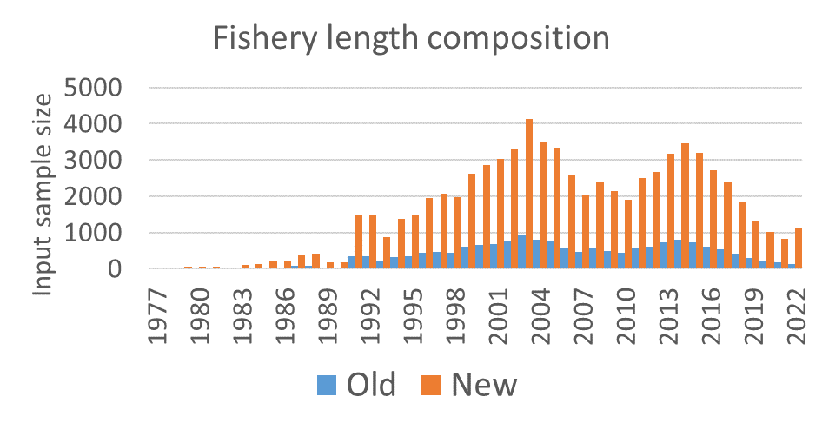
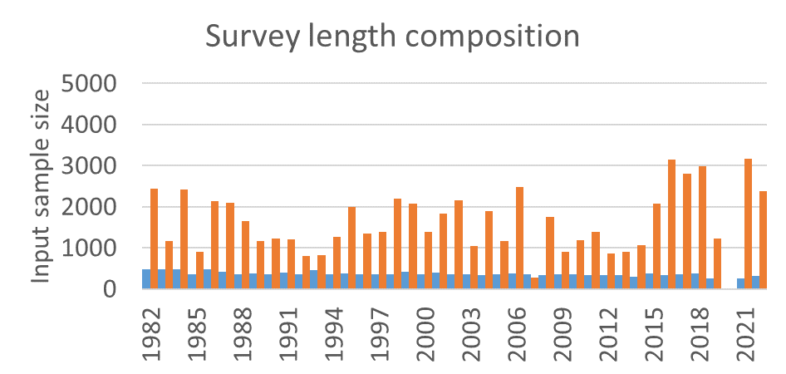
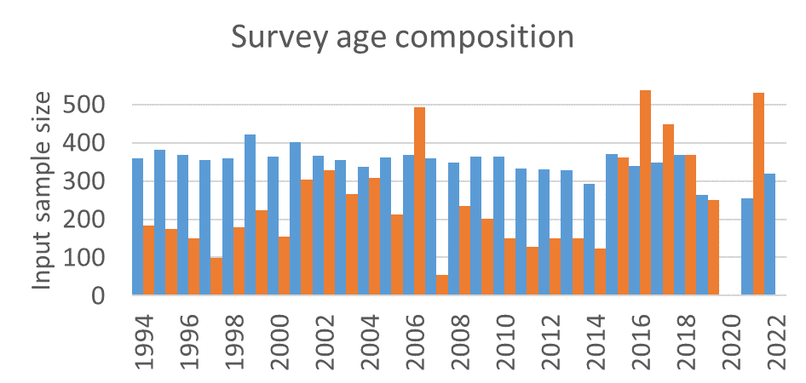
Changing initial input sample size
Model 22.2 updated
Input sample size changed to bootstrap proposed by Hulson et al. (2023)
Survey size and age composition input sample size bootstrapped
Fishery size composition input sample size uses haul number standardized to the average bootstrapped survey size composition input sample size
old mean for both = 369; length new mean = 1623, age new mean = 250
Hulson, P-J. F., B. C. Williams, M. R. Siskey, M. D. Bryan, and J. Conner. 2023. Bottom trawl survey age and length composition input sample sizes for stocks assessed with statistical catch-at-age
assessment models at the Alaska Fisheries Science Center. U.S. Dep. Commer., NOAA Tech. Memo.NMFS-AFSC-470, 38 p.

Slide 5
A simplified model
Model 23.1.0.a
Model 22.2 (Barbeaux et al. 2022) with the following changes
Removing length composition data for years with age composition data (1994-2021)
No annual devs on survey or fishery selectivity
No annual devs on L_{min}
New survey selectivity to estimate parameters 1-4 and using new option for p6
Fixing pre-2007 bias to 2022 Model 22.2 values
For the growth model fixing CV at older ages at 0.06 and fixing CV at younger ages at 0.2
Changing to standard multinomial from DM for length and age composition data
Using the iterative Francis TA1.8 weighting method to tune the model
Barbeaux, S.J., Barnett, L., Connor, J., Nielson, J., Shotwell, S.K., Siddon, E., Spies, I., Ressler, H.R., Rohan, S., Sweeney, K. and Thompson, G., 2022. 2. Assessment of the Pacific Cod Stock
in the Eastern Bering Sea. Stock Assessment and Fishery Evaluation Report for the Groundfish Resources of the Bering Sea and Aleutian Islands. North Pacific Fishery Management Council, 1007.

Slide 6
Sequential analyses with added features to simplified model
Model | Npar. +Ndevs | Annually varying growth | Annually varying survey selectivity | Max age to 12 | Catch to 1964 no regime | CAAL
23.1.0.a | 82
23.1.0.b | 176 | x
23.1.0.d | 218 | x | x
23.1.0.g | 217 | x | x | x | x
23.1.0.h | 217 | x | x | x | x | x

Slide 7
Sequential analyses with added features to simplified model
Model 23.1.0.b
Annually varying growth

Slide 8
Sequential analyses with added features to simplified model
Model 23.1.0.d
Annually varying selectivity

Slide 9
Sequential analyses with added features to simplified model
Model 23.1.0.g
Change max age from 20 to 12
Catch back to 1964 and removal of regime parameter on recruitment

Slide 10
Sequential analyses with added features to simplified model
Model 23.1.0.h
Conditional age-at-length (CAAL)

Slide 11
Sequential analyses with added features to simplified model
Annually varying growth
Annually varying growth
Annually varying selectivity
Change max age from 20 to 12
Catch back to 1964 and removal of regime parameter on recruitment
Conditional age-at-length (CAAL)

Slide 12
Sequential analyses with added features to simplified model
Annually varying growth
Annually varying growth
Annually varying selectivity
Change max age from 20 to 12
Catch back to 1964 and removal of regime parameter on recruitment
Conditional age-at-length (CAAL)

